Slide 1
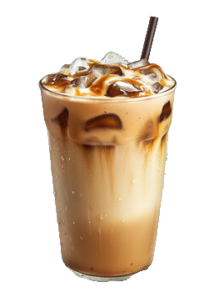
Data about Coffee
By Lizzie Best - June 30th, 2026
Francis Tuttle - Data Science and Analytics Capstone
Notes:
Hello, my name is Lizzie Best and for my capstone I have chosen to explore data about coffee. I have loved coffee since 2020 when the high amount of caffeine made me feel like I could finish college and I’ve been using it to make me feel like I can do anything ever since.

Slide 2
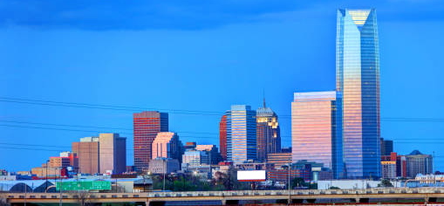
Topic and Purpose
My questions:
What is the highest and lowest rated coffee shop?
Where is the cheapest and most expensive vanilla iced latte?
What is the cheapest coffee bean in Okc?
What are the cheapest and best products to make lattes at home.
Is it cheaper than going out?
Coffee in the Oklahoma City Metro area!
Notes:
My data will be exploring some of my curiosities when it comes to coffee like what coffee shops in Oklahoma City are the highest and lowest rated? Vanilla iced lattes are my favorite drink and I’d like to know who sales the cheapest and most expensive one. I’d also like to know what is the cheapest and best way to make an iced vanilla latte at home using coffee beans in Oklahoma city.

Slide 3
Topic and Purpose
Who cares?
People who enjoy coffee and:
Are new to Oklahoma City
Want to spend less money
Want to know what coffee shop is the best
Want to know if it’s cheaper to make coffee at home.
Coffee in the Oklahoma City Metro area!
Notes:
This is data for people who love coffee and are new to Okc, want to know more about coffee around them, want to know which coffee shop is the best and the cheapest and what products are best for the cheapest and most valuable iced vanilla latte at home.

Slide 4
The Data

Slide 5
Source and Format
Source:
  Google Maps
  Google Review
  Social Media
  Coffee Shop websites
  Retail store websites
  Phone calls
Format:
  I manually entered data from these sources over 2 weeks into Excel sheets.
Notes:
Data for coffee in OKlahoma City doesn’t exist specifically for what I was looking for so I had to manually enter data into Excel sheets from info I found on Google maps, Google reviews. I had to do research on social media for the coffee shops to find information about their menus and prices in pictures posted. I went on their websites and even called them for info. For other products like espresso machines, vanilla syrups and milk I went to retail stores websites like walmart, Target and best buy.

Slide 6
Size
Size:
  CoffeeShops.csv
    17 x 56
  CoffeeShopCoffeeBrand.csv
    2 x 60
  CoffeeBeans.csv
    12 x 530
  IcedLatteCost.csv
    6 x 100
  Milk.csv
    10 x 90
  VanillaSyrups.csv
    9 x 21
  EspressoMachines.csv
    7 x 37
Notes:
I created 7 CSvs as a base to store my data and the most important key fields examples are these. My data is very biased because it is my data I found. So, there was a lot of my decision making that influenced the choices, input and also typing fatigue. I also only chose 1 coffee shop for each name of coffee shop so not every Starbucks in Okc is in the data.

Slide 7
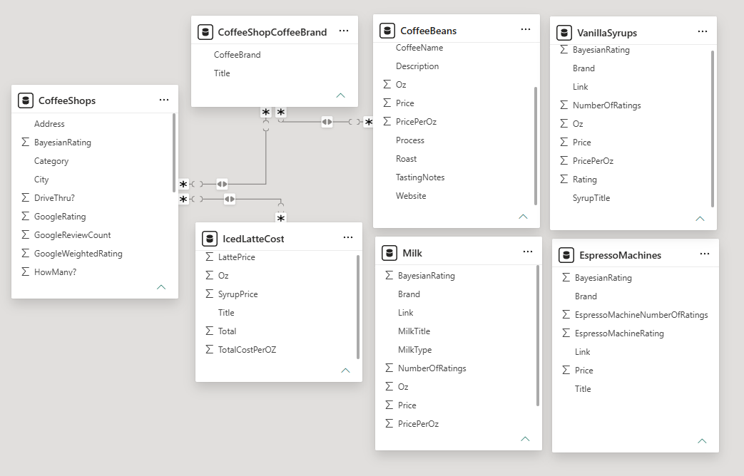
Model
Notes:
I created 7 CSvs as a base to store my data and the most important key fields examples are these. My data is very biased because it is my data I found. So, there was a lot of my decision making that influenced the choices, input and also typing fatigue. I also only chose 1 coffee shop for each name of coffee shop so not every Starbucks in Okc is in the data.

Slide 8
Key fields and Limitations
Key fields:
  Title
  Brand
  Price
  Oz
  Rating
  NumberOfRatings
Limitations:
  Biased
  Missing data
Notes:
the most important key fields examples are these. My data is very biased because it is my data I found. So, there was a lot of my decision making that influenced the choices, input and also typing fatigue. I also only chose 1 coffee shop for each name of coffee shop so not every Starbucks in Okc is in the data.

Slide 9
Questions and Metrics

Slide 10
Questions
Highest and lowest weighted rated coffee shop?
  Hours?
  How many?
  Cost?
  Drive thru?
  Coffee brand?

Slide 11
Questions
Who sales the cheapest and most expensive vanilla latte?
What is the cheapest local coffee bean?
  Origin?
  Roast?
  Process?
  Tasting Notes?

Slide 12
Questions
What is the cheapest and highest weighted rated espresso machine, milk, and vanilla syrup?
Is coffee cheaper to make at home with the cheapest espresso machine, milk, vanilla syrup, and Okc coffee bean?

Slide 13
Metrics
Price per Oz (Oz/Price)
Average
Minimum
Maximum
Total
Comparisons
Bayesian Weighted Rating
  Math formula to rank items fairly
(v / (v + m )) * R + (m / (v + m)) * C
v = Number of reviews
m = Number of reviews 0.75 or 0.85 or 0.50 percentile
R = Rating
C = Mean of Ratings
Notes:
The bayesian weighted formula decides how much to trust a coffee shop’s rating based on how many people reviewed it. The formula pulls ratings with very few reviews toward the average and lets ratings with lots of reviews stay close to their actual score. I chose the 75th percentile instead of the 50th percentile because I didn’t want to trust very heavily on coffee shops that low ratings. I coffee shop would have to have as many reviews as the top 25% for their review to be trusted as much as the average rating across all products or coffee shops.

Slide 14
Clean and Prepare the Data

Slide 15
Clean
Python for cleaning
  Replacing values
Beans_Modified.loc[501:503, 'TastingNotes'] = Beans_Modified.loc[501:503, 'TastingNotes'].str.replace('Ocoa', 'Cocoa')
  Remove extra space
Beans_Modified['Description'] = Beans_Modified['Description'].str.lstrip()
  Remove symbols
Beans_Modified['Price'] = Beans_Modified['Price'].replace('[\$]', '', regex=True).astype(float)
  Change data type
Beans_Modified['Price'] = pd.to_numeric(Beans_Modified['Price'], errors='coerce')
  Standardize weights to oz
Beans_Modified['oz'] = Beans_Modified['oz'].replace('2 lbs', '32')

Slide 16
Prepare
Excel for feature creation
  Price per Oz column
    =D2/E2 (Price/Oz)
  Totals
    =B2+D2 (LattePrice+SyrupPrice)
  Avg
    =AVERAGE(CoffeeShops!H2:H56) H2:H56 is GoogleRating

Slide 17
Methods and Tools

Slide 18

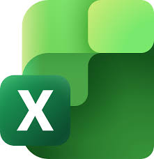
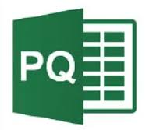
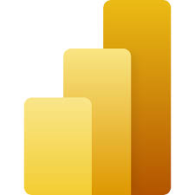
Tools
Excel
  Data entry
Python
Power Query
  Data cleaning
PowerBI
  Data analysis and visualization

Slide 19
Key Visualizations and Findings

Slide 20
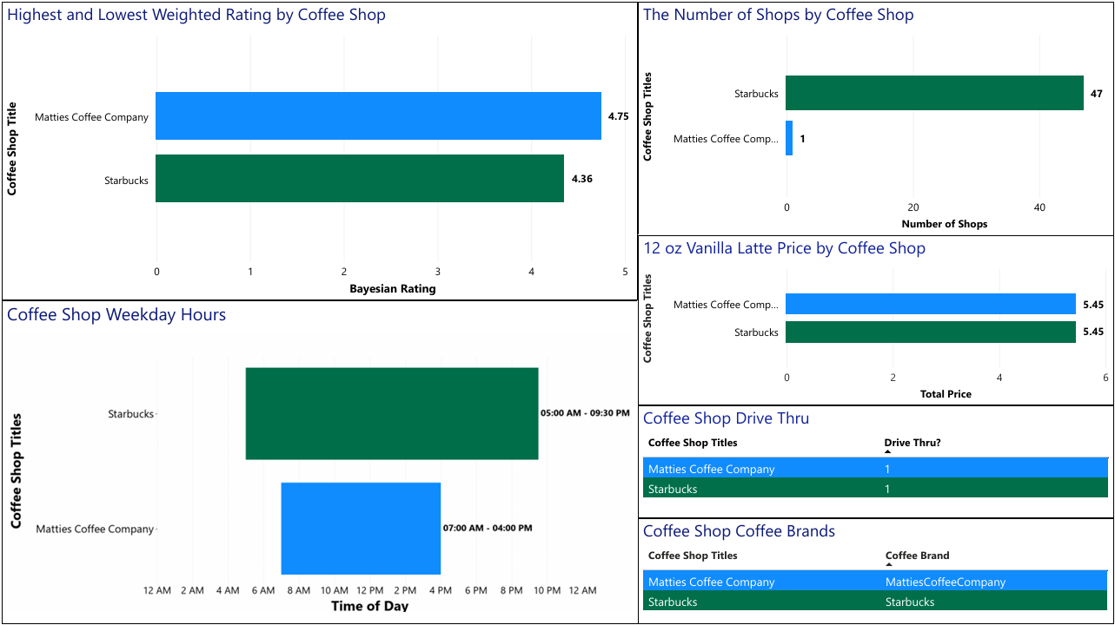

Slide 21
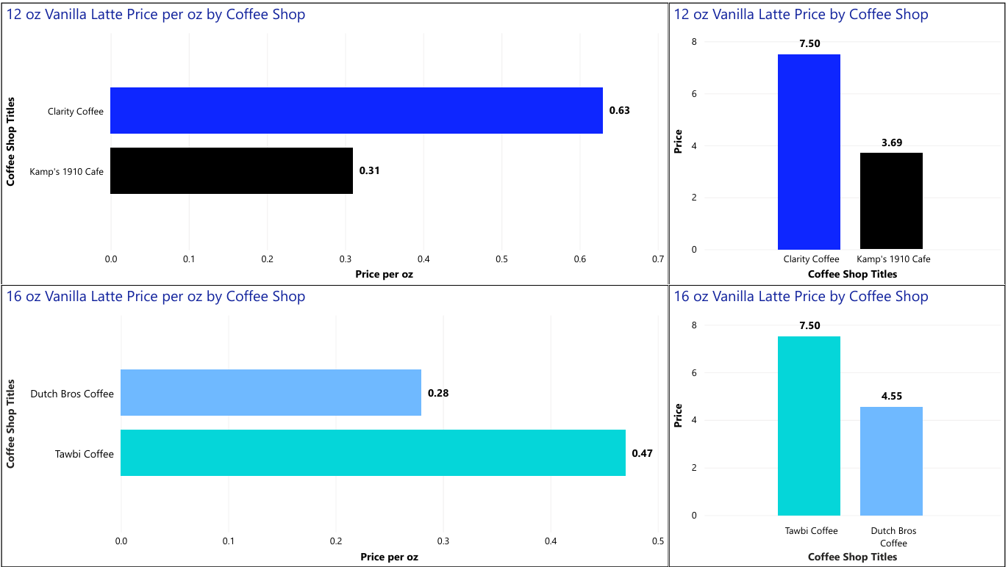

Slide 22
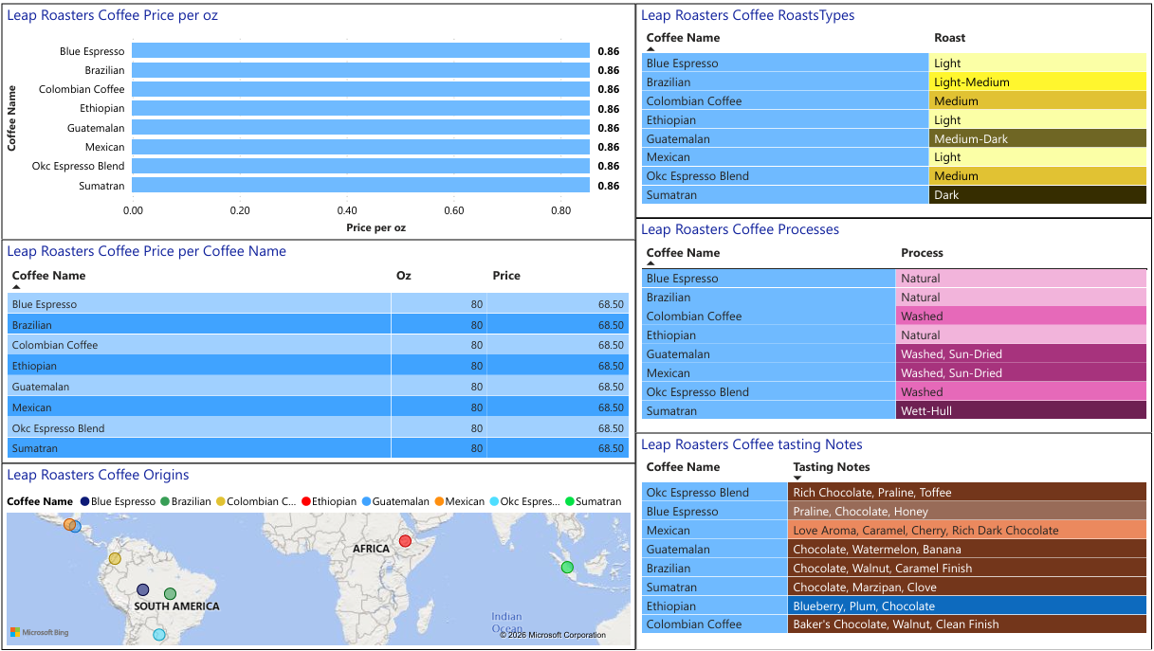

Slide 23
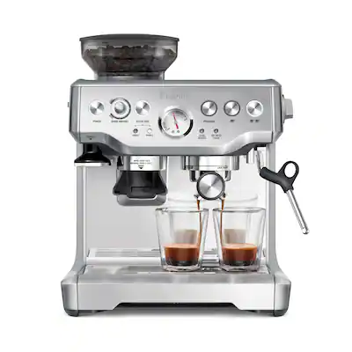
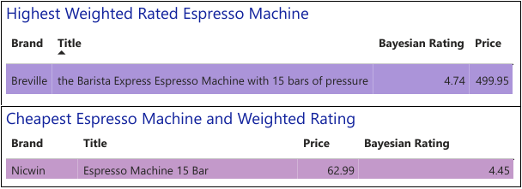
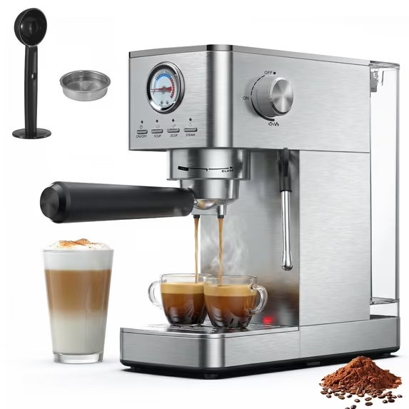

Slide 24
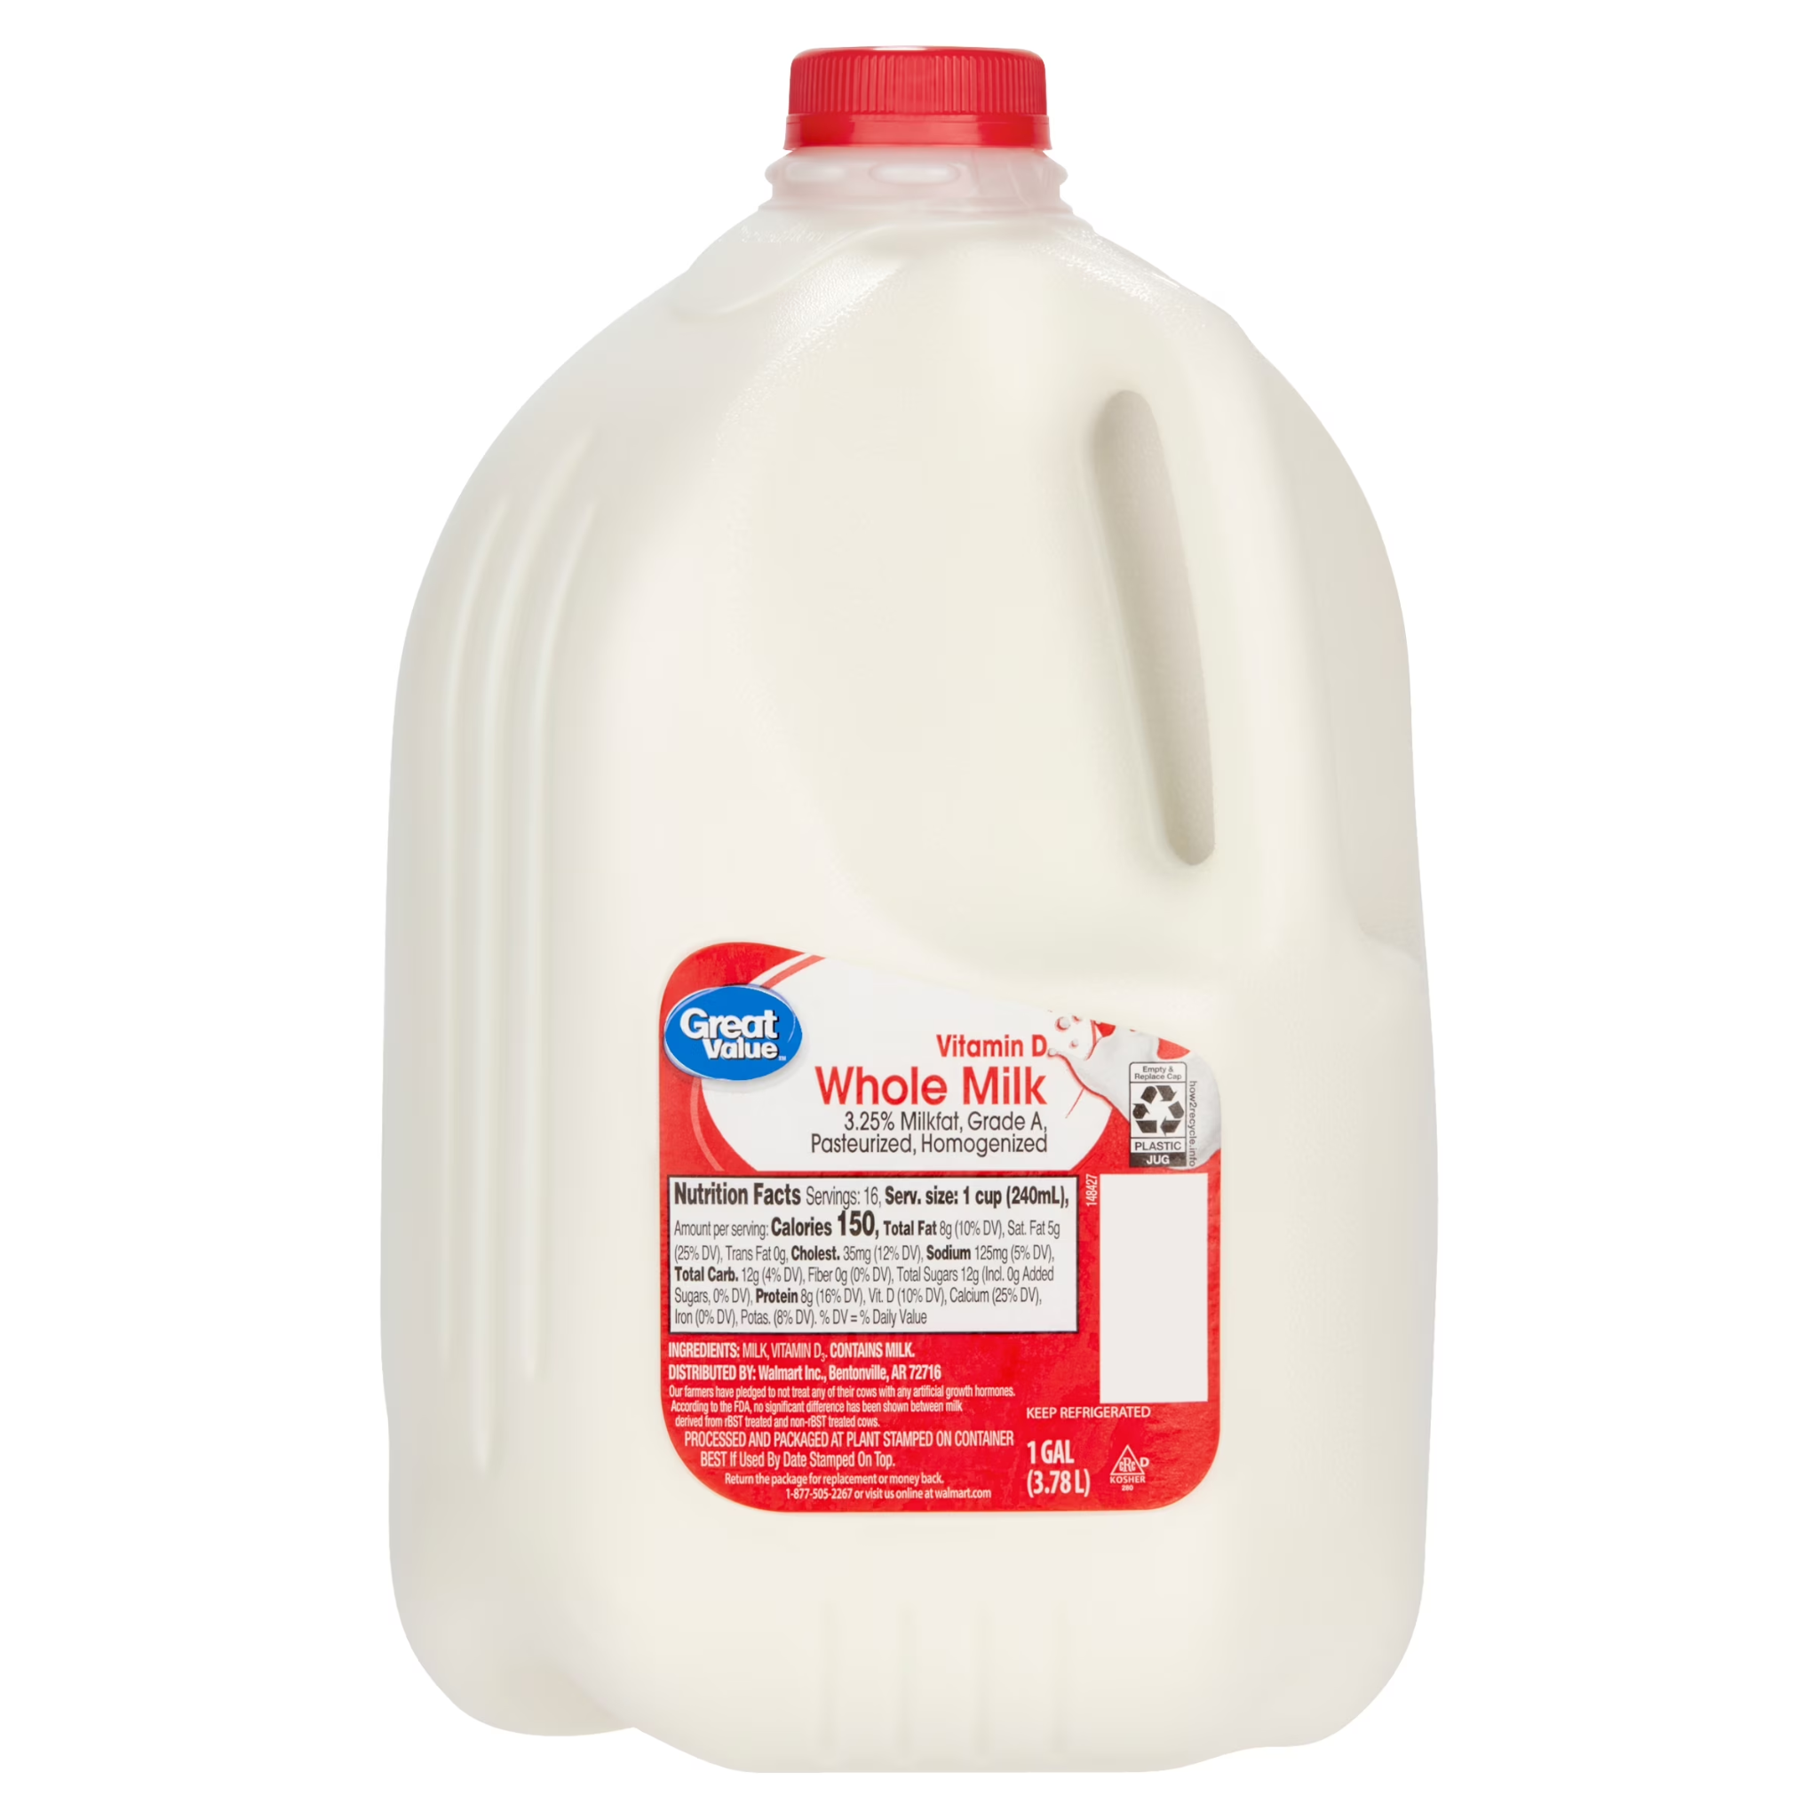
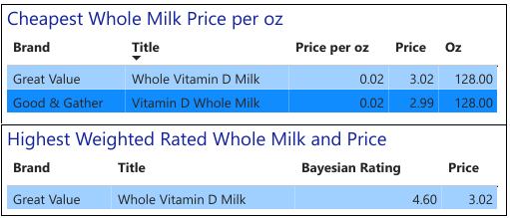
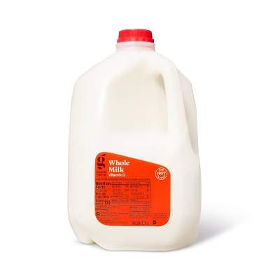

Slide 25
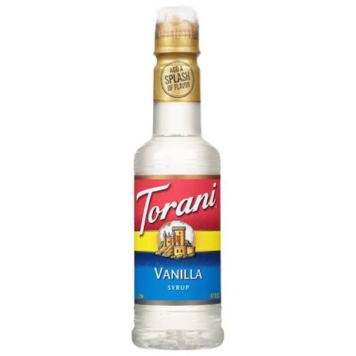
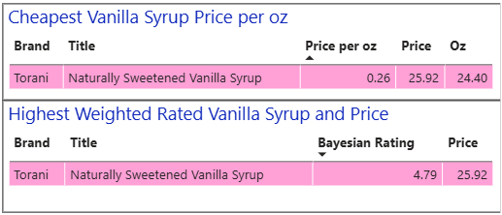

Slide 26
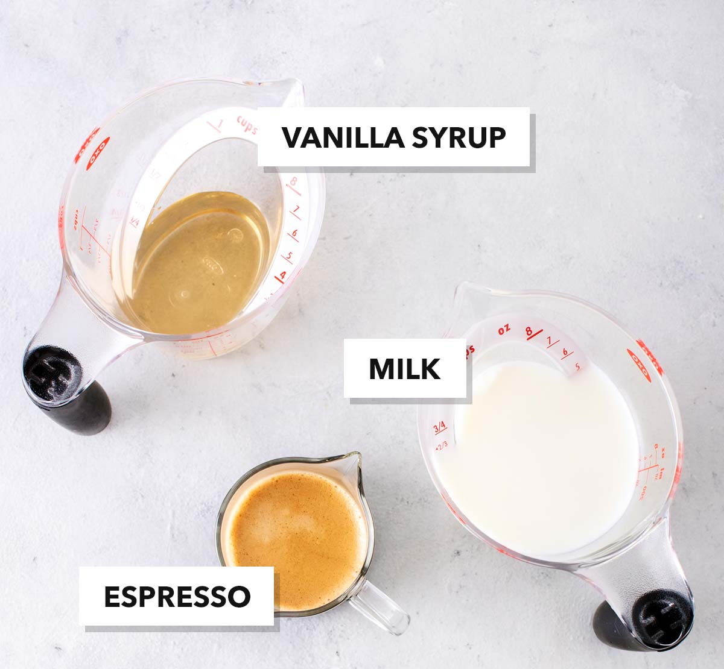
Vanilla Latte Price at Home vs. Takeout
With machine:
1 year: $716.52
Cost per Latte: $1.96
Cost per oz: $0.16
Without machine:
1 year: $653.53
Cost per Latte: $1.79
Cost per oz: $0.15
Cheapest 12 oz latte at Kamp’s 1910:
1 year: $1,346.85
Cost per Latte: $3.69
Cost per Oz: $0.31
Per latte:
0.63 oz of espresso
8 oz of milk
1 oz vanilla syrup

Slide 27
Conclusion and Recommendations

Slide 28
Conclusion
Mattie’s Coffee Company ranks the highest and Starbucks ranks the lowest.
Kamp’s 1910 and Dutch Bros sales the cheapest vanilla lattes.
Clarity and Tawbi sale the most expensive vanilla lattes.
Leaps Coffee Roasters sells the cheapest beans.

Slide 29
Conclusion
Breville ranks the highest and Nicwin is the cheapest in espresso machines.
Great Value and Good & gather is the cheapest and Great Value is also the highest rank in whole milk.
Torani is the cheapest and highest rated vanilla syrup.
It’s cheaper to make vanilla lattes at home everyday for a year than to go to the cheapest coffee shop in Okc.

Slide 30
Recommendations
Comparing locally owned to major brand names.
Adding all the data for coffee shops of multiples.
Add data in about the many types of:
  Milk
  Syrup flavors
  Espresso accessories

