Slide 1
Transformation in
Higher Education & Beyond
March 29, 2024 at 10:15 am to 11:05 am
Notes:
IT IS ENABLE NOT PROMOTE LIZZIE REMEMBER

Slide 2



Students Achieve Grades
Higher than Expected
Outside of the Classroom Walls
Lizzie Best
Sean Gausman
Notes:
Intro name, background, role at CeCE, and role in presentation

Slide 3

Hybrid Courses enable
a Transformative Learning Experience
as evidenced by students earning
better grades than expected.
Notes:
When students take Hybrid Courses they are more likely to have a Transformative Learning experience because we’ve found that their grades are higher than expected.

Slide 4

Expected Grade Difference
EGD
Average of the difference between GPA and grade
Comparing performance between groups fairly
Also Called:
Average Grade Penalty
  University of Michigan (Koester, Grom, et. al., 2016)
Average Grade Anomaly
  University of Pittsburgh (Malespina and Singh, 2022)
Notes:
Although we came up with the idea organically in the IDEA team, others have also used this metric to study student success.

Slide 5
Expected Grade Difference
EGD
Which course would you think students would say is harder?
Course
ACM.1622 DAW II
CMSC.1103 Intro Computing Sys
Notes:
Digital Audio Workstation

Slide 6
Expected Grade Difference
EGD
Which course would you think students would say is harder?
Course | Average Grade
ACM.1622 DAW II | 3.07
CMSC.1103 Intro Computing Sys | 2.95
Notes:
Let’s look at it the more classical way first, average grade.

Slide 7
Expected Grade Difference
EGD
Which course would you think students would say is harder?
Course | Average Grade | Average GPA
ACM.1622 DAW II | 3.07 | 3.24
CMSC.1103 Intro Computing Sys | 2.95 | 2.81

Slide 8
Expected Grade Difference
EGD
Which course would you think students would say is harder?
Course | Average Grade | Average GPA | EGD
ACM.1622 DAW II | 3.07 | 3.24 | -.17
CMSC.1103 Intro Computing Sys | 2.95 | 2.81 | +.15

Slide 9
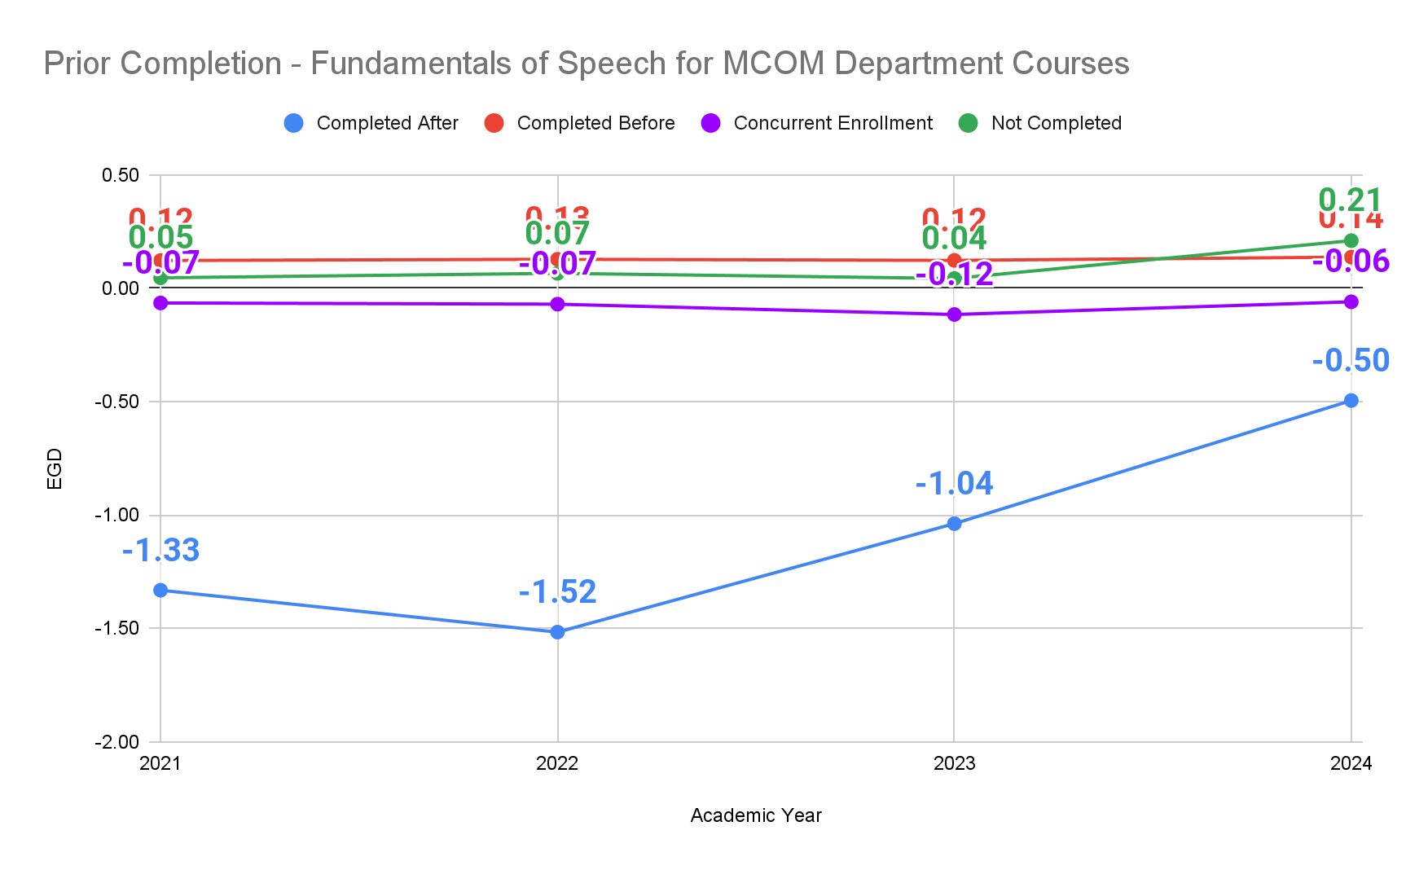
EGD Uses
Prior Completion
EGD
Notes:
Students who completed took MCOM courses prior to completing Fundamentals of Speech preform demonstrably worse.

Slide 10
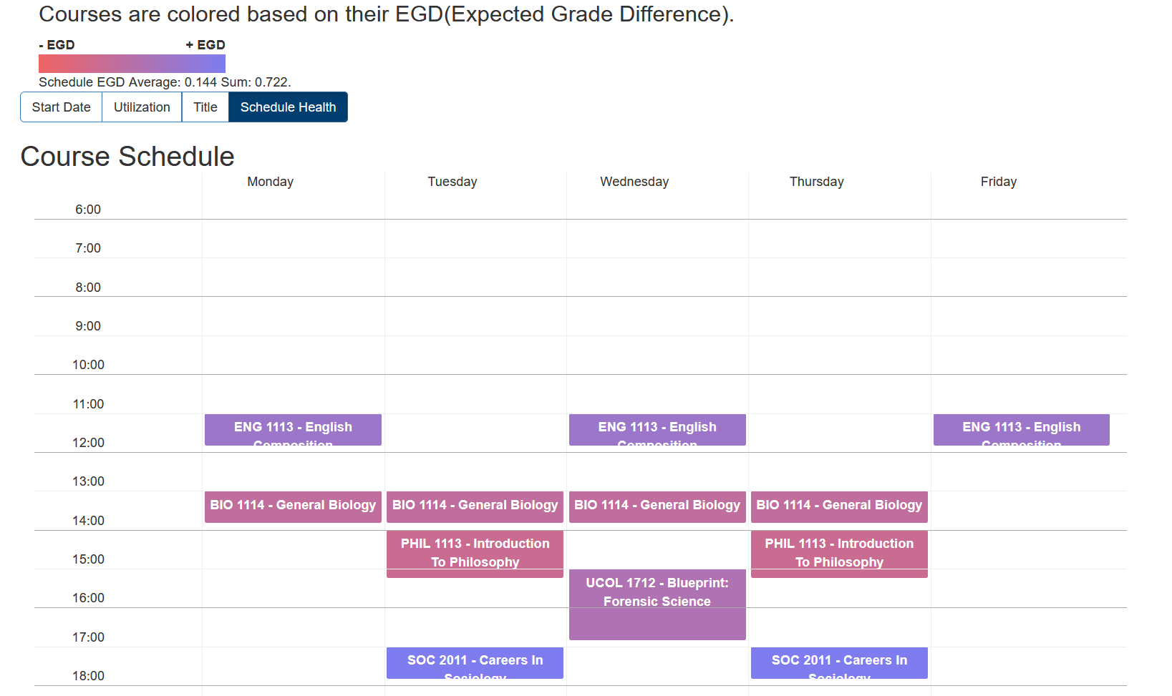
EGD Uses:
Healthy Schedule Building
EGD
Notes:
Students who completed took MCOM courses prior to completing Fundamentals of Speech preform demonstrably worse.

Slide 11
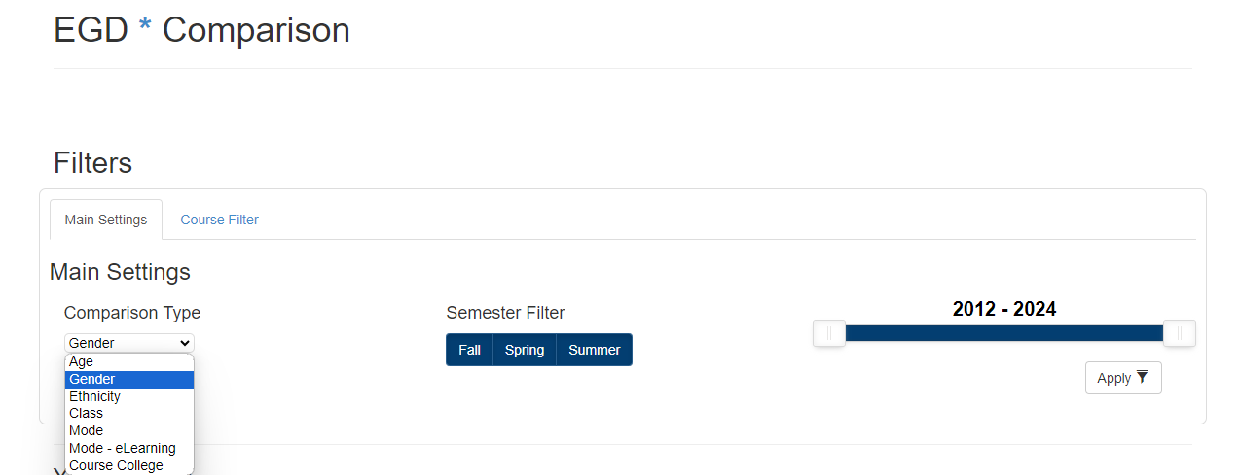
EGD Uses:
Feature Comparison Tool
EGD
Uses EGD to:
Compare performance
  by either Student or Course Features
Filter by department or course

Slide 12
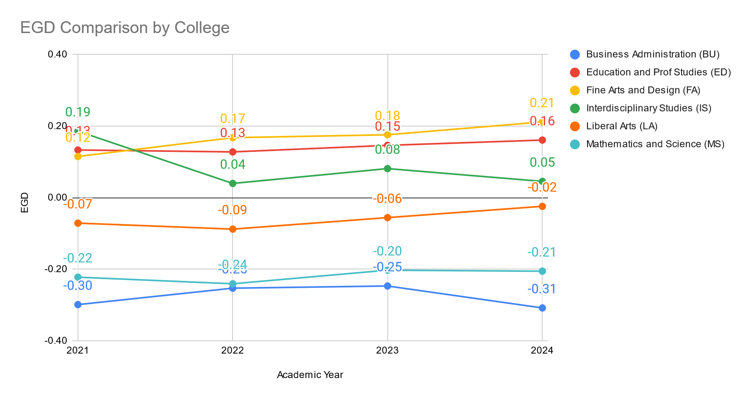
EGD Uses:
Course Feature Comparison
EGD

Slide 13
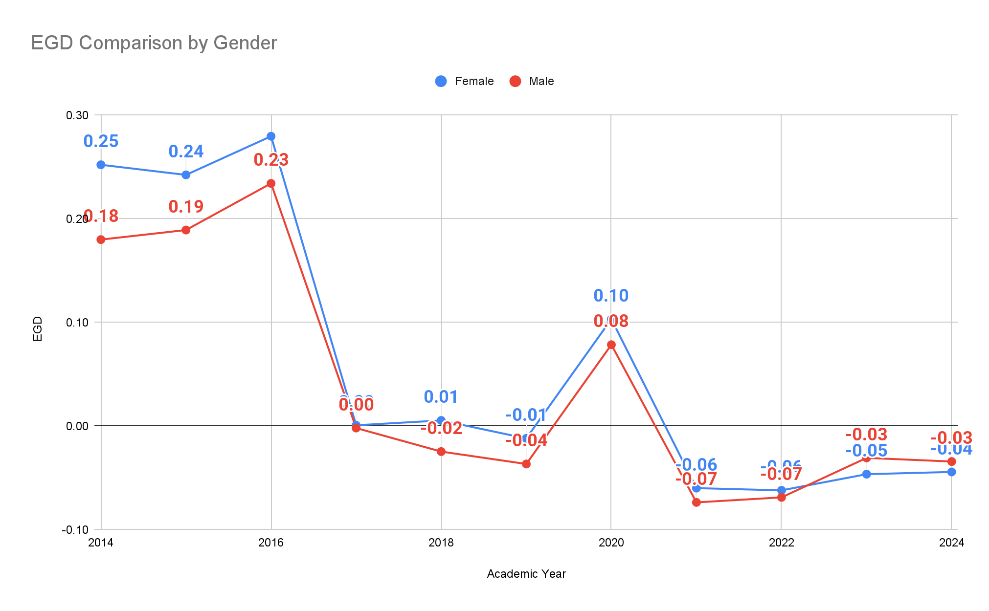
EGD Uses:
Student Feature Comparison
EGD
Notes:
Outro - EGD background
Lizzie takes over after this slide

Slide 14

Student Success Enables
a Transformative Learning Experience
The EGD tool shows if students performed
better in courses than usual
based on their GPA,
helping us identify what allows students to excel.
Notes:
The expected gtrade difference tool allows to understand where they are likely to get better grades than usual. There is something occurring to allow studnets to do this.

Slide 15
Student Success Enables
a Transformative Learning Experience
EGD scores that are higher reveals what variables promote a Transformative Learning experience
so students can show
their true potential.
Notes:
When students are giving performances that are much better than usual for a particular reason that is being discovered by using the filtering option with the Expected Grade Difference tool then this reveals what is allowing students to excel

Slide 16
Student Success Signifies
a Transformative Learning Experience
A Transformative Learning Environment allows for:
Independence
Health and Wellness
Disciplined
Notes:
This variable that is allowing students to have better grades than expected must be providing them the ability to alter their performance for the better by providing Independence, health and wellness and promoting discipline whihc are transformative.

Slide 17

ACTIVITY!
Your name is and this is your life:
23 years old
Taking a minimum of 12 credits for FASFA financial aid
Work at Chili’s from 1 pm - 6:30 pm on weekdays
Single parent of a 2-year-old boy
Notes:
We’re now going to do an activity where you will step into the shoes of a struggling student who is 23 YRS OLD, a SINGLE PARENT of a CHILD IN THEIR TERRIBLE 2’s, you WORK AT CHILIS BABY BACK RIBS FROM 1PM--6:30PM and your excited that you won’t have to soon hopefully when you graduate after your last semester here soon. You will get to experience what variable maybe providing some way for you to have an experience in a course that is not only providing you the ability to show your potential but transforming your perceptions of yourself and the world.

Slide 18
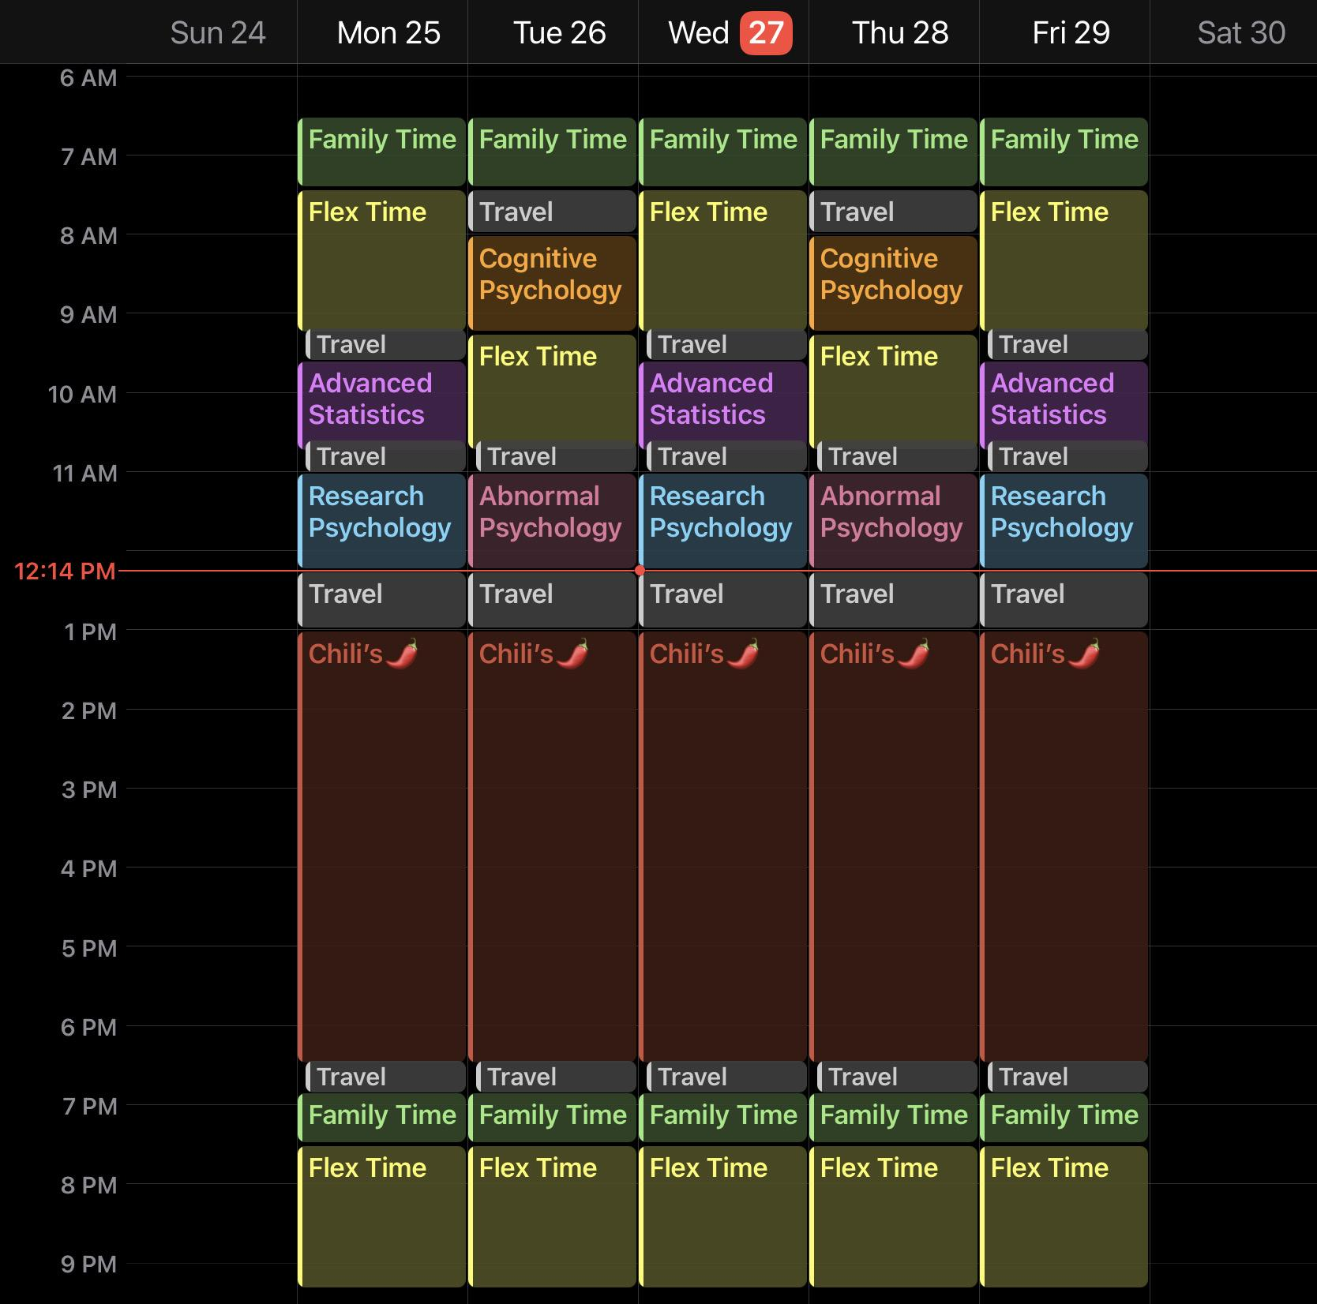
ACTIVITY!
This is your schedule
while going to class everyday.
Notes:
This is your schedule as a struggling student taking 12 credit hours which is the full time limit so you can qualify for financial aid from FASFA. You are taking 4 courses this semester while going to class everyday that has you moving around a lot throughout the day and not having much time to focus on yourself, your health, wellness. You have a lot of discipline here but it’s more of a discipline with time not as much discipline with the content to absorb the content as well to show your capabilities in course work.
Describe 1 day in some detail.

Slide 19
ACTIVITY!
This is your schedule
while going to class everyday.
Notes:
There is such heavy repetiion in this schedule that your life for 3-4 months becomes sp mundane that you might be on autopilot most of the time and just going through the motions in class and just letting everyone else answer the questions in class who have the energy to do so. So your confidence in your abilities are low, your time to eat and take care of health appointments is very limited. This area of time right here can be used to have discipline with the content but your discipline is so focused on getting to places on time that you’re not using discipline to absorb the content. This semester is going to zoom by with not fulfillment or satisfaction and your performance might reflect that.

Slide 20
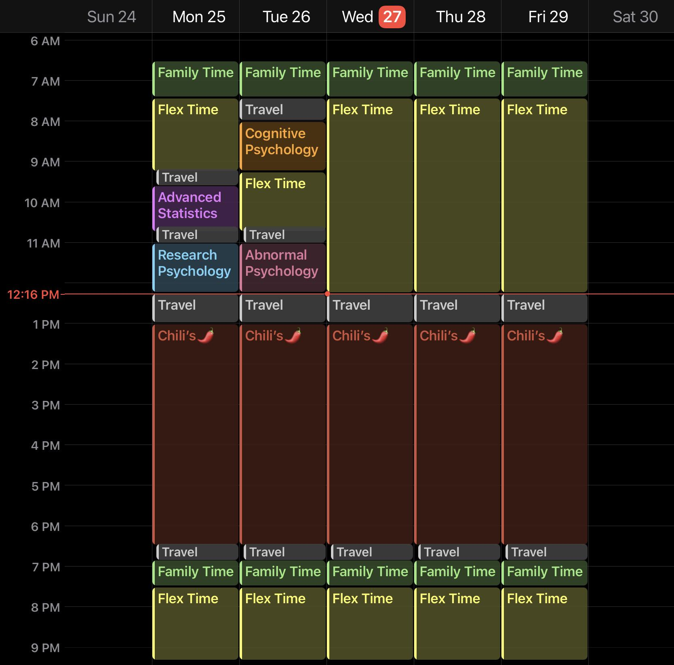
ACTIVITY!
This is your schedule
with hybrid!
Notes:
Now we have changed your schedule because some hybrid sections are actually available for you to take. Look at these 3 days that you have now to take care of yourself. You have around 4 ½ hours on wednesday, thursday, and friday to develop discipline with the content instead of of focusing on travel time. You can delve into the content in your own space with your own thoughts and ideas at a pace that is helpful to you. You can pause and reflect with out zoning out to focus on where the next place you need to be at soon. You’re satisfied with what you learned, used your own ideas, and can show what you learned and absorbed on the content that you usually might not have been able to do previously in other modes. You get some structure from the professor in class and can set sail on your own for 3 days.
Imagine you have a difficult assignment in Advanced Statistics, but this week is pretty light on other homework. The flexibility of Hybrid allows you to shift your focus where needed.

Slide 21
Reflection
The Hybrid schedule allows:
Independence
Health and wellness
Discipline
Notes:
This schedule is giving you a pace of time and a place to gain some independence in your learning, be able to take care of yourself to be your best version and develop discipline to spark the possibility of learning on your own for the rest of you rlife. Which most people who teach imagine that their inspiring their students to be life-long learners even after they graduate. For them to sail into the world on their own to learn they need time to learn to navigate on their own. Hybrid courses give students to grab the wheel partially so soon they can do it on their own for a lifetime.

Slide 22
Data for UCO 2021-2024
Expected Grade Difference
EGD
We analyzed the data for UCO from 2021 to 2024
comparing the different modes to better understand the weak points in students performances.
Notes:
How we understood that there is probability that these courses are giving students a transformative experience with the content that is propelling them to excel more than usual was by looking at the EGD for UcO

Slide 23
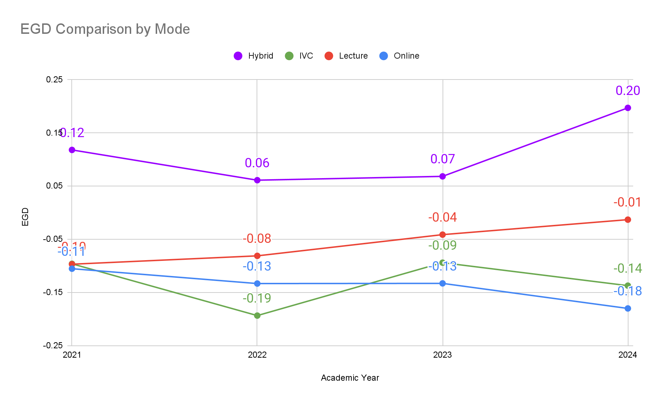
Data for UCO 2021-2024
Expected Grade Difference
EGD
Notes:
This is the Expected Grade Difference data for UCO from 2021 to 2024 comparing Hybrid, IVC, Lecture and the fully online mode. As you can see, Hybrid courses have an average grade difference that is higher in the Hybrid environment. Lecture

Slide 24
Data for UCO 2021-2024
Expected Grade Difference
EGD
Since students have an Expected Grade Difference
that is higher than what is expected in hybrid courses, this shows that elements of online learning can enable a Transformative Learning Experience.
Notes:
Hybrid courses ENABLE students to have a transformative learning experience and excel at courses better than usual.

Slide 25

Hybrid Courses enable
Transformative Learning Experiences
Hybrid courses allow:
Unconventional students
Pavlakou, Kalachanis, et al. 2019
Notes:
Plenty of other studies have also claimed that the Hybrid environment is Transformative! This study about the Transformative quality of eLearning in adult training is that Hybrid courses are easily accessible and the wediactional material is accessible all the time instead of trying to bottle up all the course material for a day in 45 minutes to hopefully remember some of it. Since the course material is accessible all the time and not in a 45 m,inute window time frame. This allows students like the hypothetical but alo realistic studnet in the activity to be able to attend college and be a studen like some kids imagine doing to do their dream job.

Slide 26
Hybrid Courses enable
Transformative Learning Experiences
Elements of online Learning allows:
Unconventional students
Pavlakou, Kalachanis, et al. 2019
Self-direction and an
alter to a higher learning state
Brieger, Earl, et al 2020
Notes:
Another study talks about how students have some self-direction because in Hybrid courses you can easily give them learning goals and objectives that they can direct themselves through and they have to access the learning materials themselves. They have an alter in their perception of the world from the content which can be easily tracked with hybrid course platforms. The instructor is still a pivotal part of the courses because your preparing the supplies on the boat with a sturdy sail for them to discover a whole new world with. You can track how they’ve explored your content and accomplished goals. You can see if they have experienced an alteration in perception by challenging previous opinions give at the beginning of the course and comparing to their perceptions ofd things based on what they have learned so far altogether as a whole. This is difficult to do when the content isn’t learner centered like it is in other modes like lecture or it’s way too learner centered with no help to set the sail like in fully online.

Slide 27
Hybrid Courses enable
Transformative Learning Experiences
Elements of online Learning allows:
Unconventional students
Pavlakou, Kalachanis, et al. 2019
Self-direction and an
alter to a higher learning state
Brieger, Earl, et al 2020
Enriching learning experiences
with self-confidence
Branchetti, Capone, et al. 2021
Notes:
This study asked students before taking distance learning courses how they expected to perform and how they think the experience would have been. Many of these students before Covid believed that they would really struggle with the course content and feel isolated. After taking some distance learning thanks to Covid they realized that they were capable of absorbing the course materials and still felt connected to the other students because you could easily converse and discuss with the professor and other students. They realized that they had more time with the content than they usually would have while face to face in class and could go back to materials as much as they needed to which made them feel more fulfilled with the course materials. It gave them confidence to know that they could navigate and understand the materials just by having access to it. College students are capable of more than what they think and still need guidance in areas that the instructor can easily do. This is a great condition to be able to excel better than usual and having a personal change in how you see the world.

Slide 28
Hybrid Courses enable
Transformative Learning Experiences
You get to:
Have time to absorb content
Independently think
Challenge ideas without judgment
Gain confidence
Notes:
They have an enriching experience with the content because they get to go back to it instead of trying to cram it all in their notes in 45 minutes. They can go back and listen! They also don’t have to experience being shy in the classroom and having everyone else answer the questions. They get to answer questions on their own with confidence.

Slide 29
Hybrid Courses enable
Transformative Learning Experiences
You get to:
Have time to absorb content
Independently think
Challenge ideas without judgment
Gain confidence
Actually attend college
Notes:
They have an enriching experience with the content because they get to go back to it instead of trying to cram it all in their notes in 45 minutes. They can go back and listen! They also don’t have to experience being shy in the classroom and having everyone else answer the questions. They get to answer questions on their own with confidence.

Slide 30
Hybrid Courses enable
a Transformative Learning Experience
as evidenced by students earning
better grades than expected.
Notes:
We are here to explain how students can achieve higher grades than what is expected outside of the classroom walls.

Slide 31

Interactive Activity
Critical Thought
Why do you think Hybrid out performs both Lecture and Online when it is composed of both?
Notes:
They have an enriching experience with the content because they get to go back to it instead of trying to cram it all in their notes in 45 minutes. They can go back and listen! They also don’t have to experience being shy in the classroom and having everyone else answer the questions. They get to answer questions on their own with confidence.

Slide 32
Interactive Activity
Critical Thought
Why do you think Hybrid out performs both Lecture and Online when it is composed of both?
Are there features of Hybrid you can incorporate in other modes?
Notes:
They have an enriching experience with the content because they get to go back to it instead of trying to cram it all in their notes in 45 minutes. They can go back and listen! They also don’t have to experience being shy in the classroom and having everyone else answer the questions. They get to answer questions on their own with confidence.

Slide 33

References
Connecting Theory and Practice:
Reviewing Six Learning Theories to Inform Online Instruction.
Brieger, Earl, et al.
European Journal of Training and Development
vol. 44, no. ⅘, 2020
Impact of Grade Penalty in First-Year Foundational Science Courses on Female Engineering Majors
Malespina, Alysa & Singh, Chandralekha
International Journal of Engineering Education
2022
Distance - Learning Goes Viral: Redefining the Teaching Boundaries in the Transformative Pedagogy Perspective.
Branchetti, Laura, et al.
Journal of E-Learning & Knowledge Society
vol. 17, no. 2, June 2021
E-Learning and Transformative Learning in Adult Training
Patterns of Gendered Performance Difference in Introductory STEM Courses
Pavlakou, Evgenia, et al.
Journal of Studies in Education (Las Vegas, Nev.)
vol. 9, no. 2, 2019
Koester, Benjamin P., et al.
arXiv.org
2016

Slide 34


Do you have any questions?
Thank you!
Lizzie Best
Research Assistant
bbest5@uco.edu
Sean Gausman
Web Developer
sgausman@uco.edu

